Slide 1

Team Details
Team name: DOONDILEONS
Team leader name: NALLIMILLI SURYA PRAKASH REDDY
Problem Statement: Tech-Medics 108+ – Improving emergency medical response efficiency.

Slide 2

Problem statement & Solution (Bridging the Gap: From Panic to Precision)
The Problem
Black Box” Anxiety: Callers experience panic due to no visibility of ambulance location or arrival time.
Connectivity Barrier: Emergency solutions fail in remote areas and highways with poor internet access.
Dispatch Delays: Manual coordination and verbal address errors delay critical response during the Golden Hour.
Our Solution – Tech-Medics 108+
Real-Time Visibility: Live ambulance tracking provides clarity and reassurance to victims.
Offline Reliability: Location information is transmitted even without internet connectivity.
Smart Dispatching: Automated nearest-ambulance assignment significantly reduces response time.

Slide 3
Opportunities,Differentiation & Viability
Viability
Exact GPS eliminates location ambiguity
Transparency reduces panic and repeat calls
Automation cuts response time from minutes to seconds
Differentiation
Live ambulance visibility replaces blind waiting
Automated dispatch replaces manual coordination
Works even without internet connectivity
Calm, emergency-focused user experience
Opportunities
Deployable for government 108 & Smart Cities
Valuable for insurers via faster response outcomes
Scalable to private hospital ambulance fleets

Slide 4
List of features offered by the solution
Live Ambulance Tracking
Patients can see where the ambulance is and when it will arrive.
Works Without Internet
Shares location using SMS when mobile data is unavailable.
Faster Ambulance Assignment
Automatically sends the nearest ambulance to the emergency.
Driver-Friendly System
Ambulance drivers get clear directions and status updates.
Simple & Calm Design
Easy-to-use interface for stressful emergency situations.

Slide 5
Technologies used in the solution
Backend & Core Services
Python (Flask) with Socket.IO enables secure, real-time emergency coordination.
Data Management
SQLite with SQLAlchemy ORM ensures reliable and structured system data.
Frontend Experience
HTML5, JavaScript, and CSS3 deliver a responsive Glassmorphism-based user interface.
Mapping & Navigation
Leaflet.js powers live, interactive location tracking and visualization.

Slide 6
Google Technologies used in the solution
Google Maps Platform
Used to generate universal location links for accurate and device-compatible navigation.
Google Drive
Secure cloud storage for project assets and demo content.
Android Ecosystem
Mobile-first design optimized for Android devices used by emergency responders.
Chromium Engine
High-performance rendering through Chrome-based browsers for smooth user experience.

Slide 7
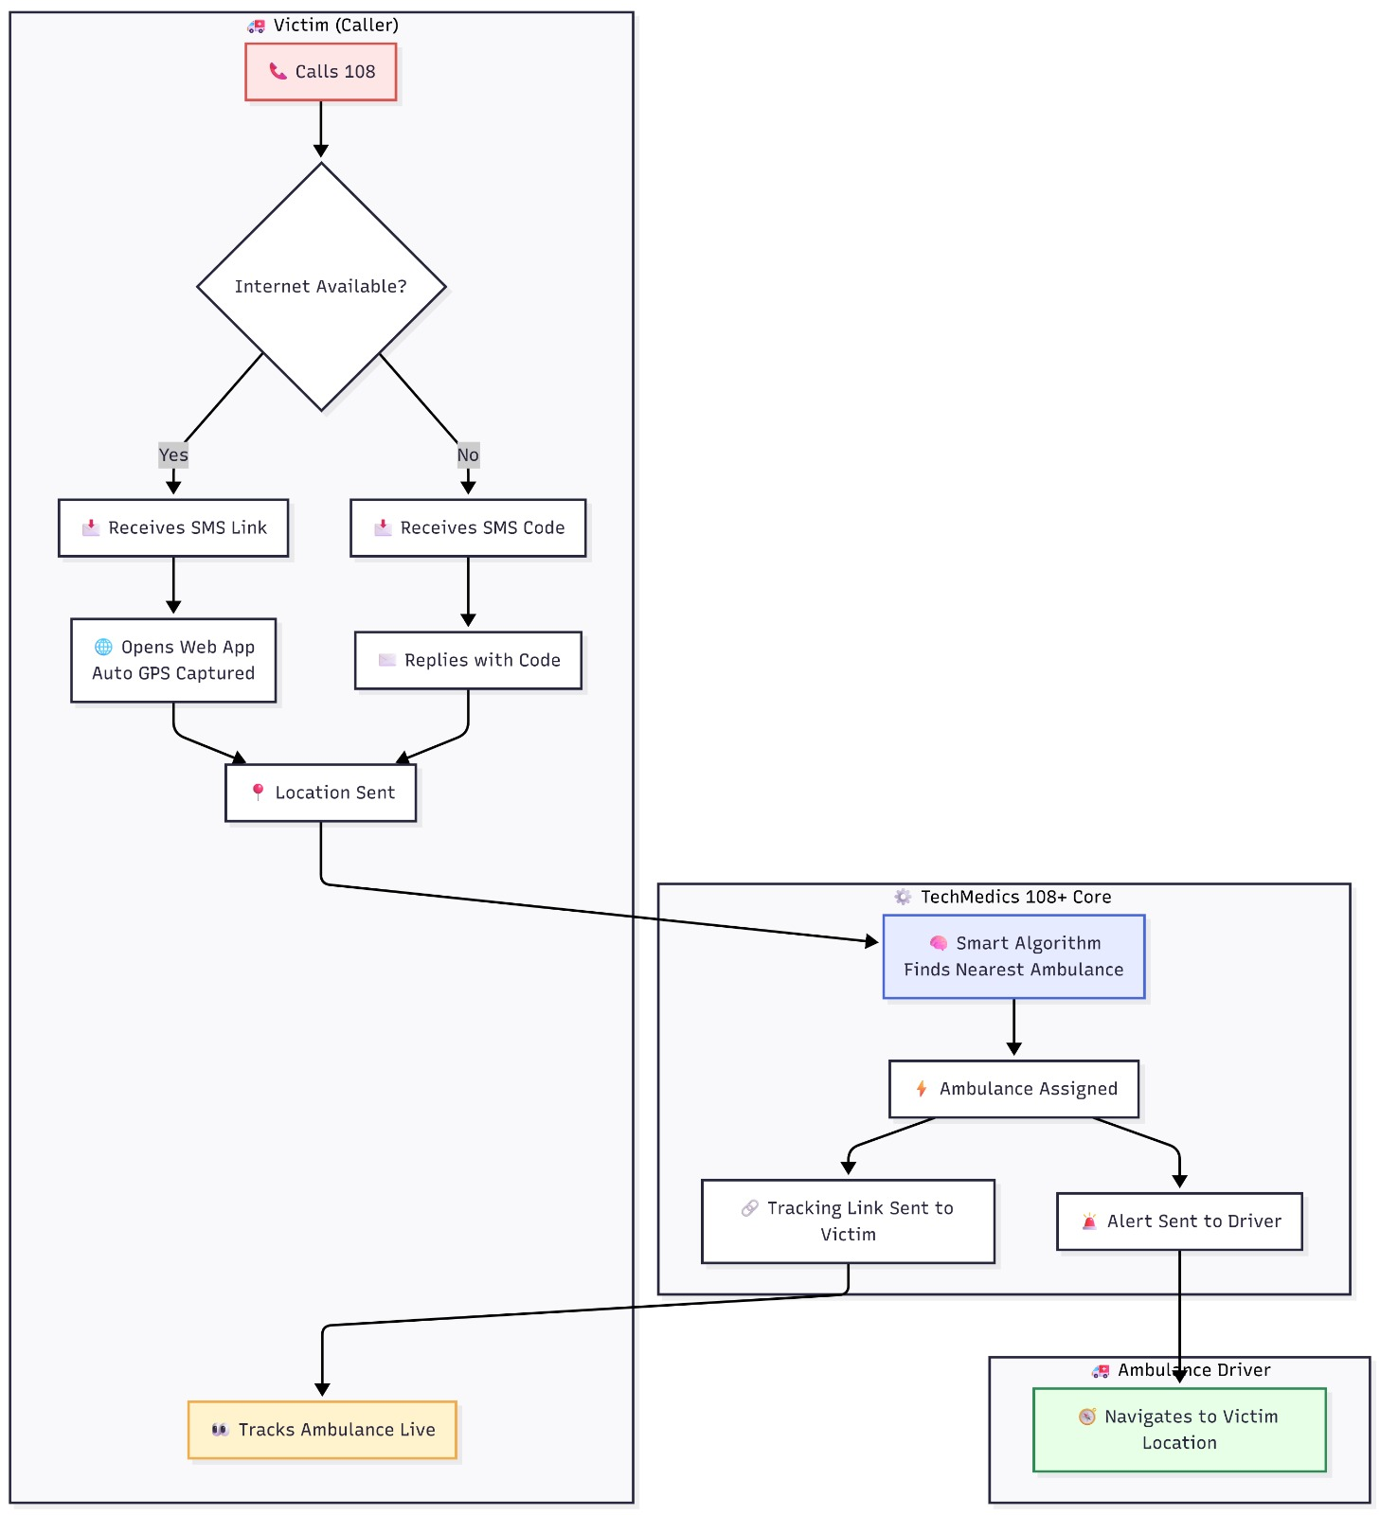
Process
flow diagram

Slide 8
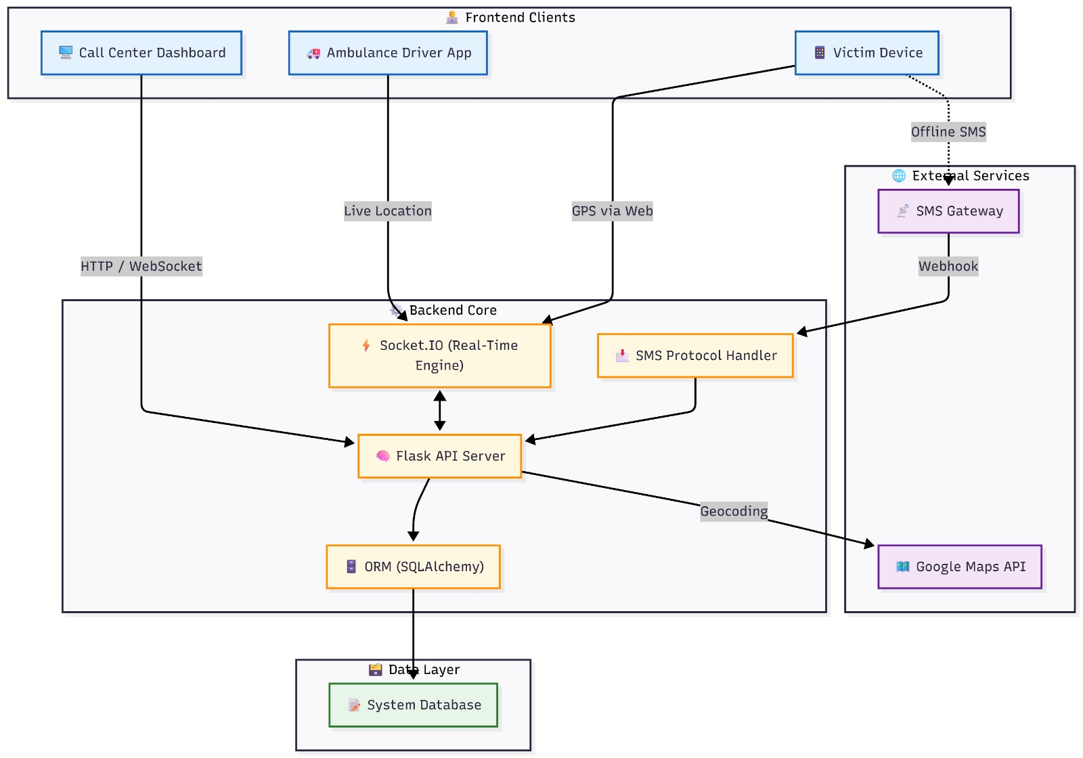
Architecture diagram of the proposed solution

Slide 9
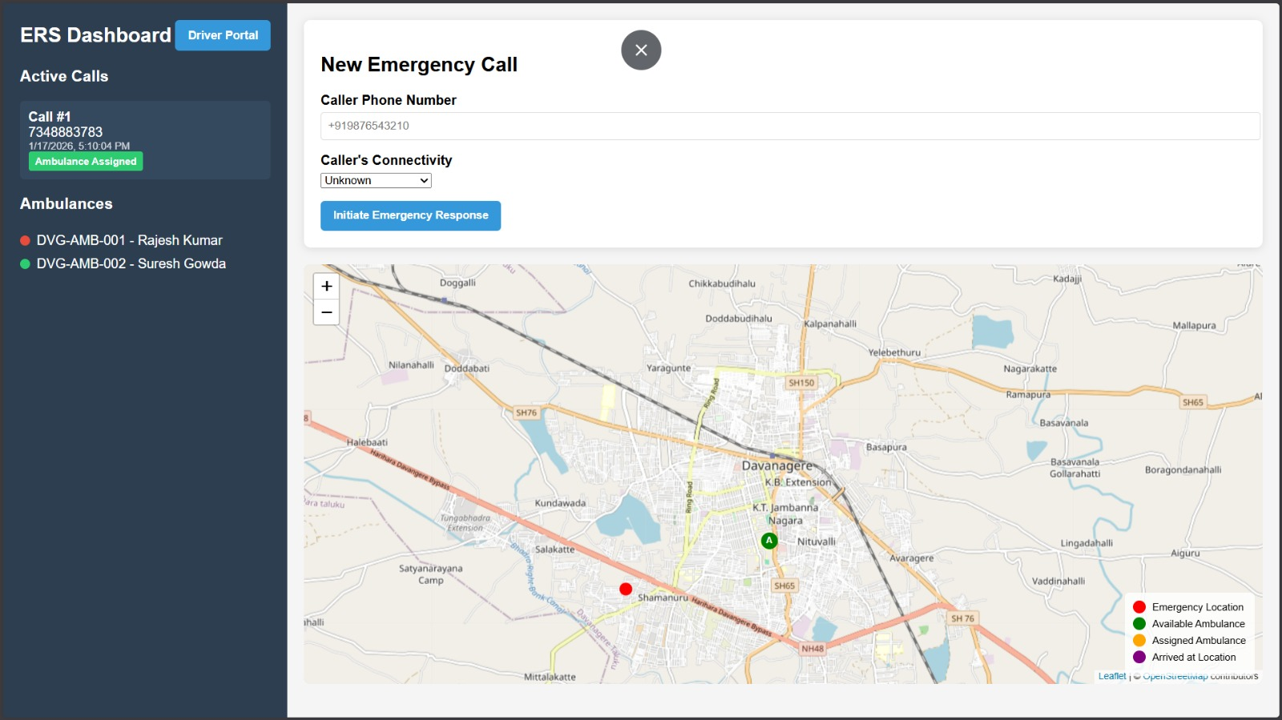
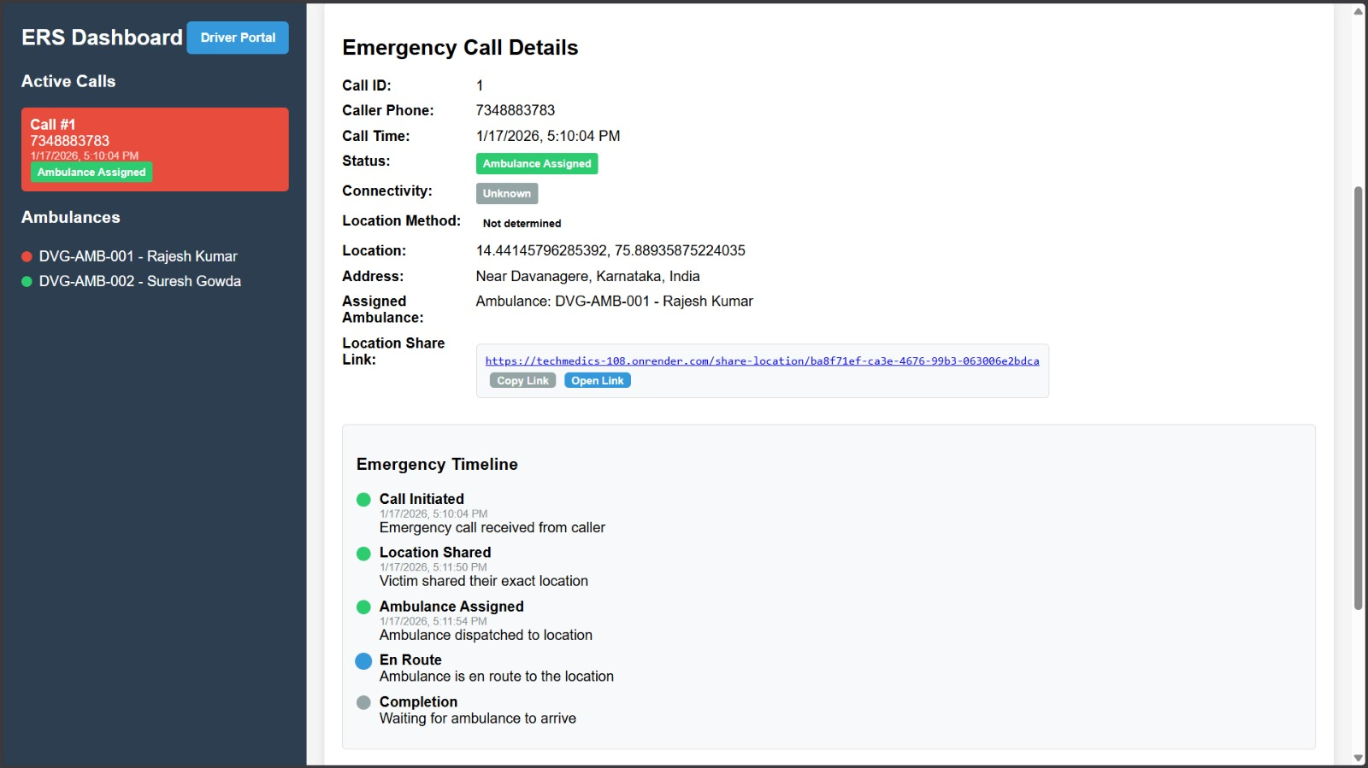
Snapshots of the MVP

Slide 10
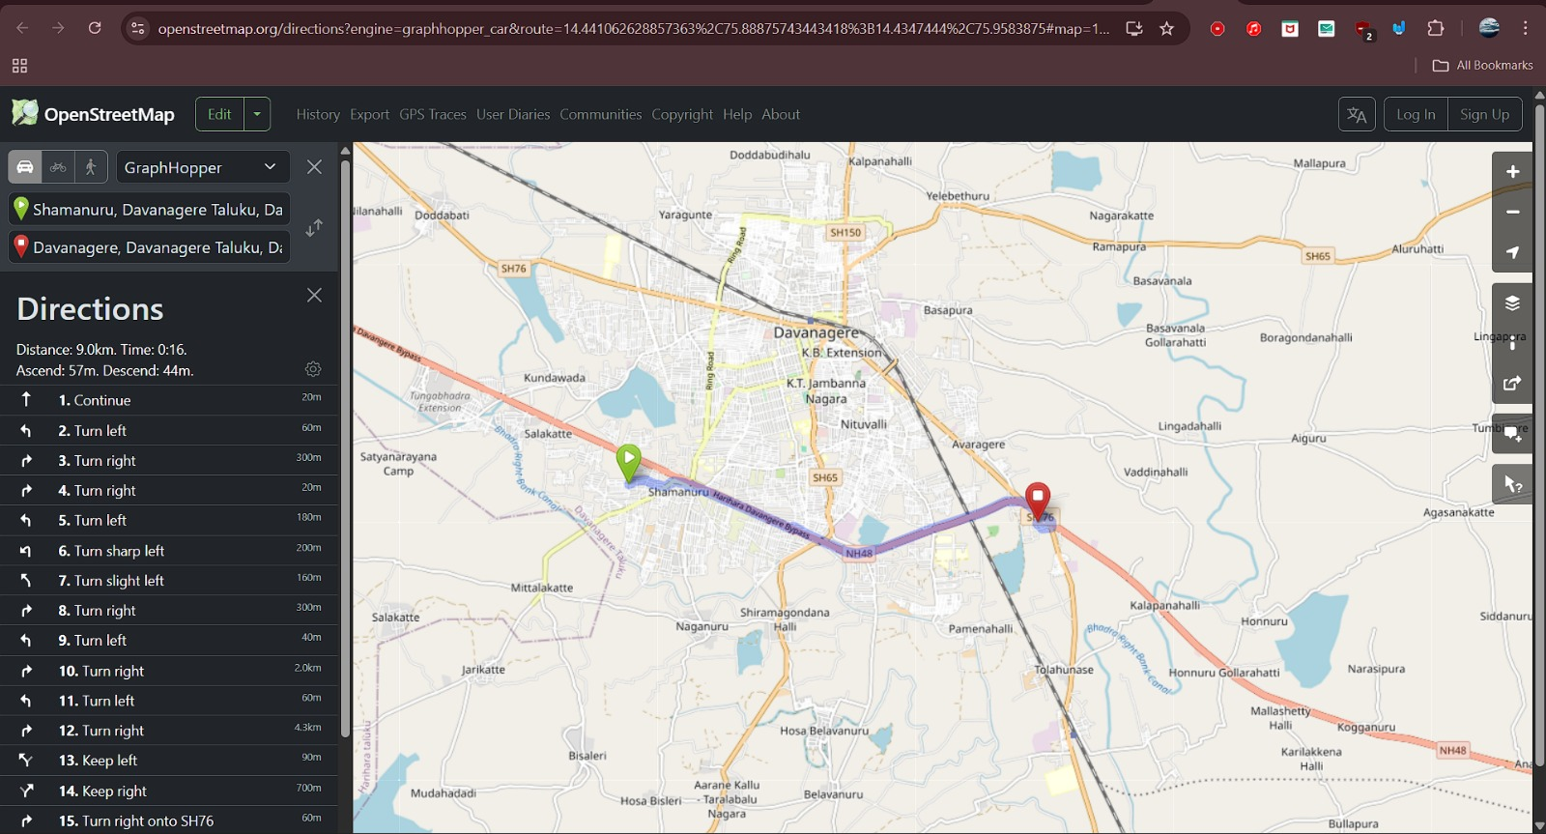
Snapshots of the MVP

Slide 11
Future Development
AI Predictive Deployment Uses historical accident data to pre-position ambulances in high-risk zones, cutting response time significantly.
Smart Traffic Integration Enables automated green corridors by syncing with Smart City traffic signals for faster ambulance movement.
Vernacular Voice Assistance Provides hands-free, AI-powered voice support in regional languages for rural and highway drivers.
Smart Ambulance (IoT Telemetry) Streams real-time patient vitals to hospitals enroute, allowing emergency teams to prepare in advance.

Slide 12
Provide links to your:
GitHub Public Repository
Demo Video Link
MVP Link
link : https://github.com/Suryareddy180/108plus
link : https://drive.google.com/file/d/1XYbmHxfMWaXSHama5ysZLa_DLIiKNXnn/view?usp=sharing
link : https://techmedics-108.onrender.com/

Slide 13

Thank you!

